Slide 1

BIT HACK’23 – (07.11.2023- 08.11.2023)
HARDWARE
INTELLIGENT COLOUR SORTING CONVEYOR BELT

Slide 2
TEAM DETAILS
TEAM MEMBERS
SHRIKANTH S (7376221EC518) TEAM LEADER
SIBIRAJ S (7376221EC519)
PONVASANTH G (7376221EC513)
VISHNUVARTHAN M (7376221EC525)
GUIDE DETAILS
INTERN GUIDE NAME :GOKULAKRISHNAN S
INTERN ID:IN7285

Slide 3
PROBLEM STATEMENT ANALYSIS
Machine vision technology has become increasingly popular in recent years due to its ability to automate and improve various industrial and commercial processes. One such application is the separation of different coloured objects.
This project aims to develop a simple machine vision system that can separate different coloured objects using webcam, LabVIEW interface, Raspberry pi microcontroller and a servo motor.
The system can be used in various applications such as sorting coloured candies, fruits, and vegetables. Additionally, the project has also been implemented using a My RIO controller, which is a programmable embedded device, to enhance the performance of the system.

Slide 4
UNIQUENESS
The design of the system involves four main components: Webcam, MyRIO microcontroller, Raspberry pi microcontroller and a servo motor. The webcam captures images of the objects, which are then processed using LabVIEW software.
The system has been implemented using a MyRIO controller, which is connected to the webcam and the servo motor. The MyRIO controller receives the images from the webcam, processes them using LabVIEW software, and controls the servo motor to move the separator based on the colour of the object.
The Raspberry pi and webcam is also used for the image detection which detects the hand and stops the conveyor when the hand is detected and it ensures the safety of the operator.

Slide 5
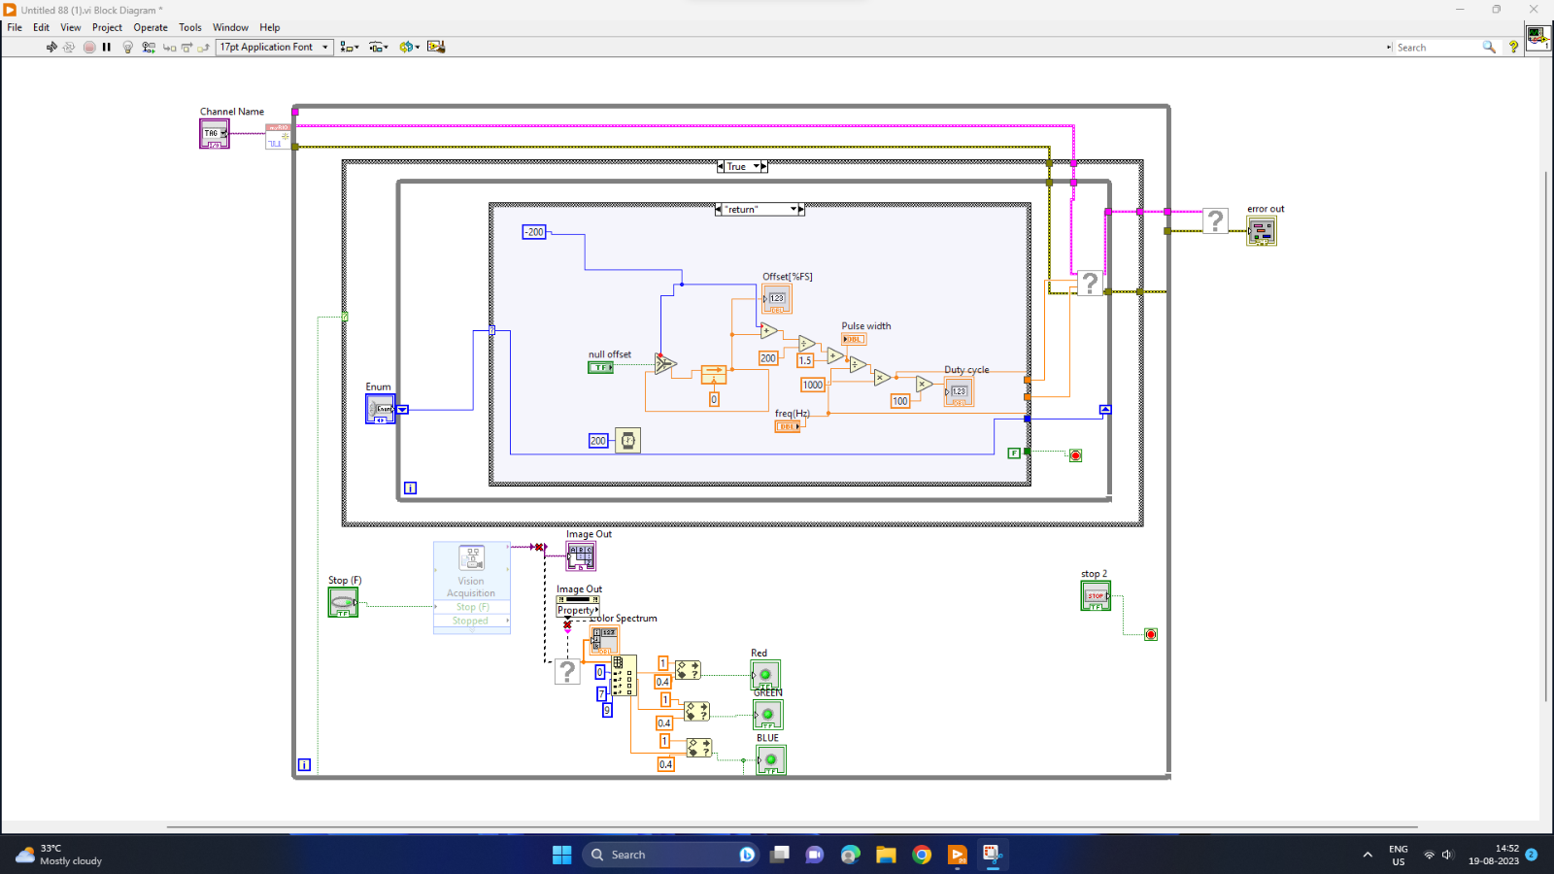
DESIGN-BLOCK DIAGRAM

Slide 6
DESIGN-FRONT PANEL

Slide 7
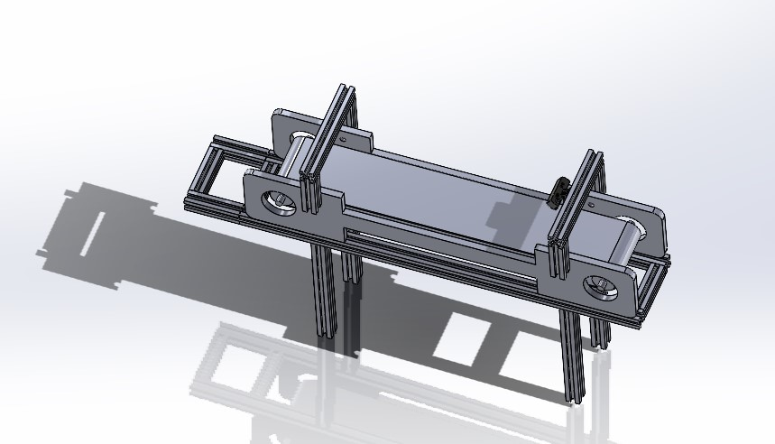
3D MODEL

Slide 8
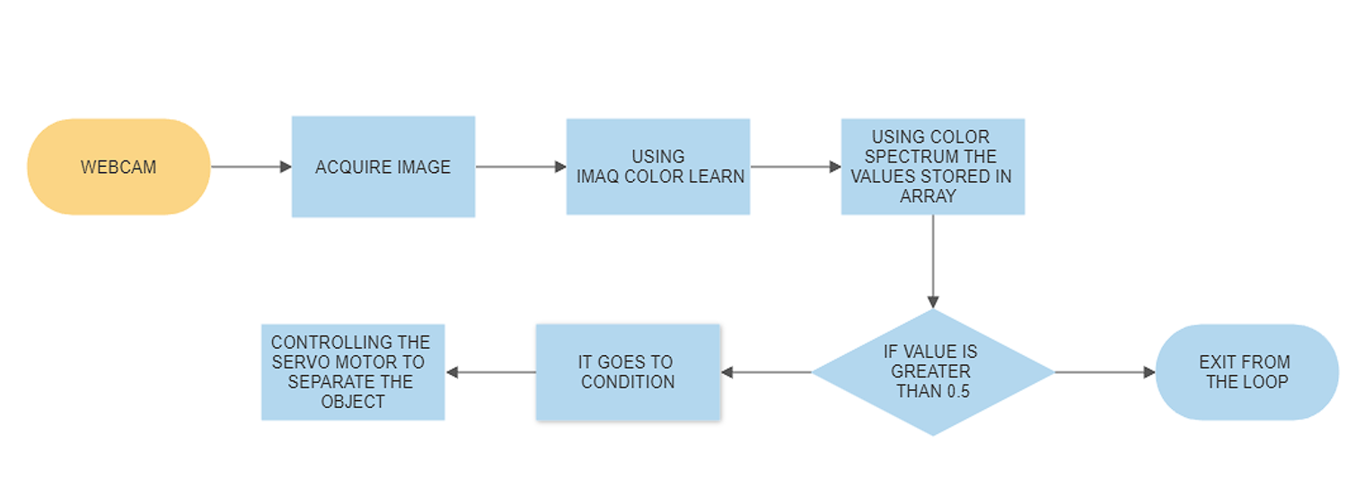
FLOW CHART

Slide 9
METHODOLOGY
DEVELOPMENT PHASES
The methodology involves the following steps:
Capturing images of the objects using a webcam
Processing the images using LabVIEW software to determine the colour of the object.
Controlling the servo motor to sort the objects of certain colour resolutions which has been trained by the user using the webcam.
Controlling the movement conveyor with the Raspberry pi for the safety precautions, when the hand is detected in the particular risky areas.

Slide 10
TECHNICAL STANDARD IMPLEMENTATION
The NI MyRio-1900 (USIN LABVIEW)
RASPBERRY PI 4
WEBCAM(Video resolution 640 x 480 (30 FPS))
SERVO MOTOR(Operating Voltage: 4.8V~6.0V Operating speed: 0.12sec/60 degree Output torque: 1.6kg/cm 4.8V)

Slide 11
ADDITIONAL FEATURES
When a hand is detected in the webcam, the conveyor's operation automatically stops until the hand is removed from the risky zone. This can be achieved by using a Raspberry Pi, which can be programmed to detect the presence of a hand in the webcam's field of view and send a signal to the conveyor to stop its operation.
The Raspberry Pi can be programmed using computer vision and machine learning techniques to recognize hand gestures and identify the position of the hand in real-time, Once the hand is removed from the risky zone, the Raspberry Pi can send a signal to the conveyor to resume its operation.
This system can be adjusted and altered to suit specific requirements, such as changing the size of the risky zone or modifying the hand gesture recognition algorithm.

Slide 12
RESULTS AND DISCUSSION
The results demonstrate the successful sorting of different coloured objects using both the systems. The systems can accurately detect and sort objects based on their colour, making them suitable for various applications.
The discussion involves the advantages of using the MyRIO controller over other microcontroller, such as higher processing power and speed, the ability to integrate with other sensors and devices and the adaptability of any circumstances.
The accuracy of the system depends on the lighting conditions and the quality of the webcam. The system can process different objects of different colours and resolutions, and the sorting time is less than a second per object.
The machine can be applied in various industries that require colour sorting of products, such as food processing, agriculture, textile industries, and recycling.

Slide 13
TECHNOLOGY / SKILL REQUIREMENT - CONTRIBUTOR MAPPING
S.No | Skills / Technologies Required for the project | Team member’ s Name (Contributing the required skill / technology)
1 | CIRCUIT DESIGN | SHRIKANTH S(7376221EC518)
2 | LABVIEW | PONVASANTH G(7376221EC513 )
3 | RASPBERRY PI | SIBIRAJ S(7376221EC519)
 | 3D DESIGN | SHRIKANTH S(7376221EC518)
4 | FRAMEWORK | VISHNUVARTHAN M(7376221EC525)

Slide 14


